Slide 1
LAMP Clinician Guide
Prepared December 14, 2020

Slide 2
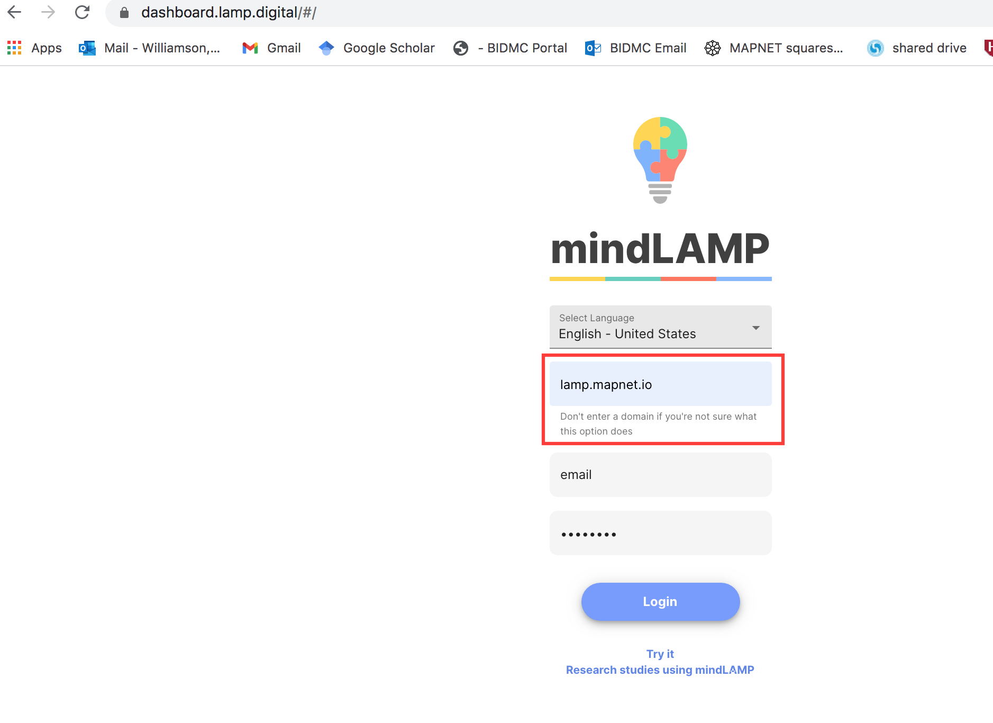
Open a browser or your LAMP application and input the username and password you created for yourself. The domain is “lamp.mapnet.io”

Slide 3
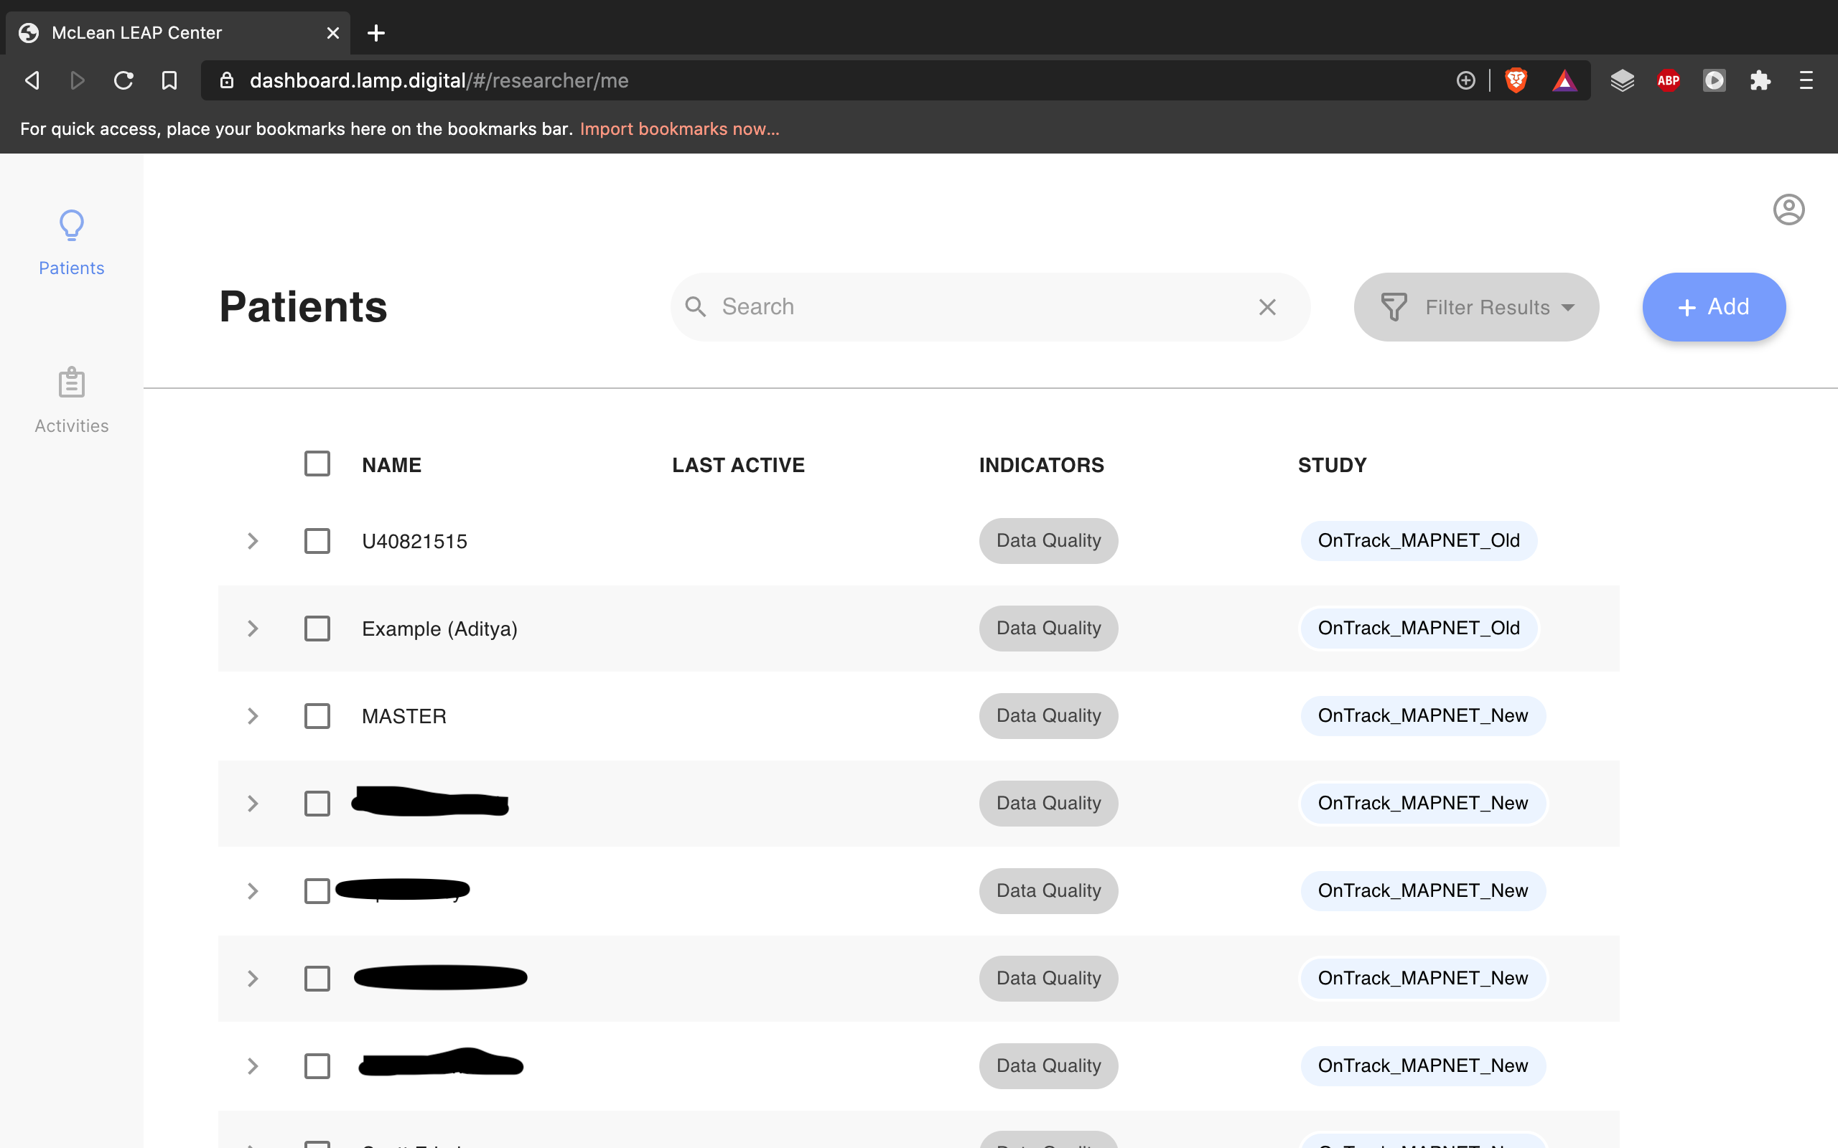
You will see a list of patients

Slide 4
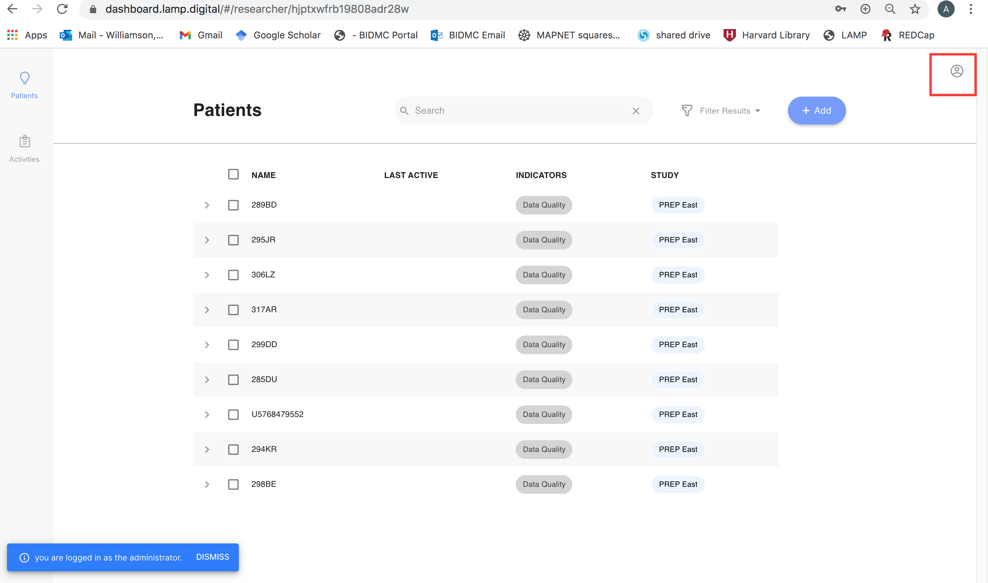
To add a new clinician or researcher to your LAMP Team, click the icon at the top right of the screen

Slide 5
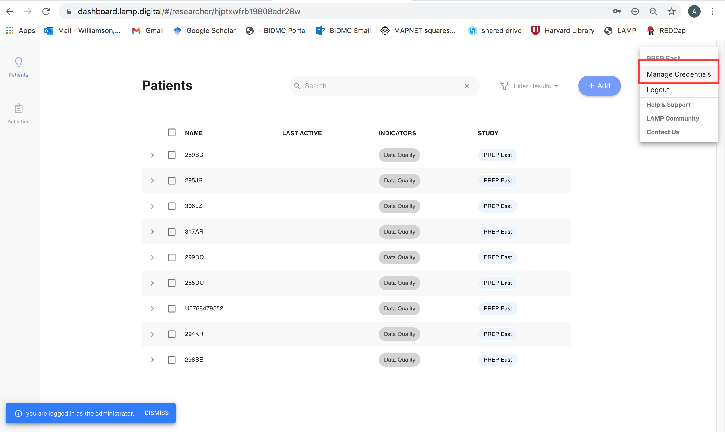
Then, click “Manage credentials”

Slide 6
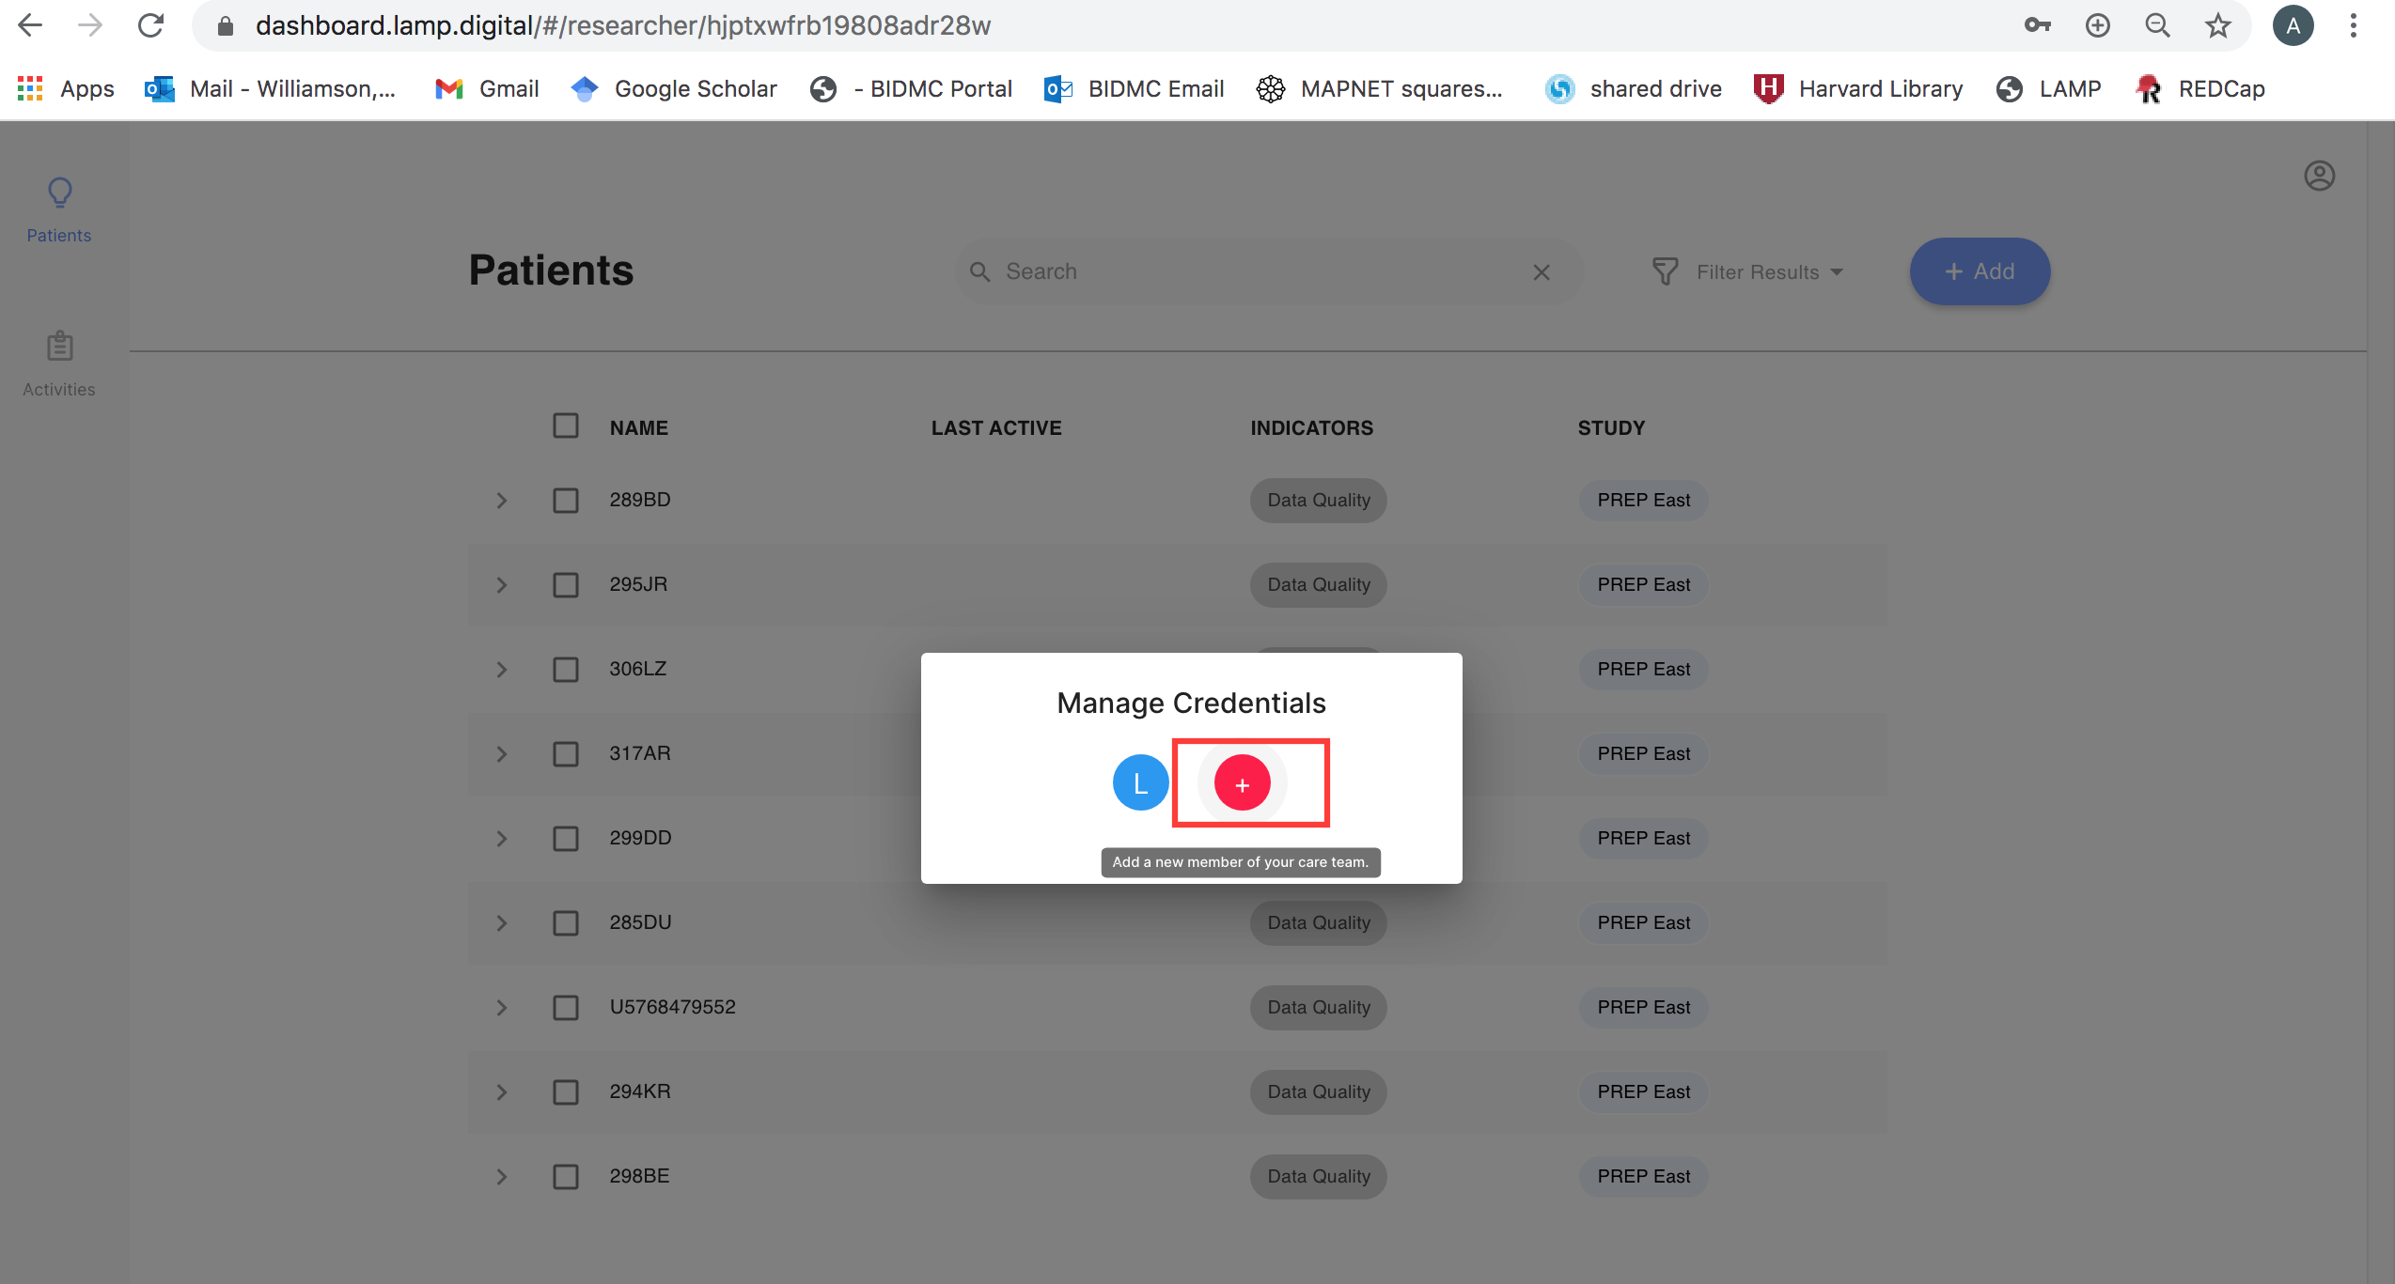
Click the + icon

Slide 7
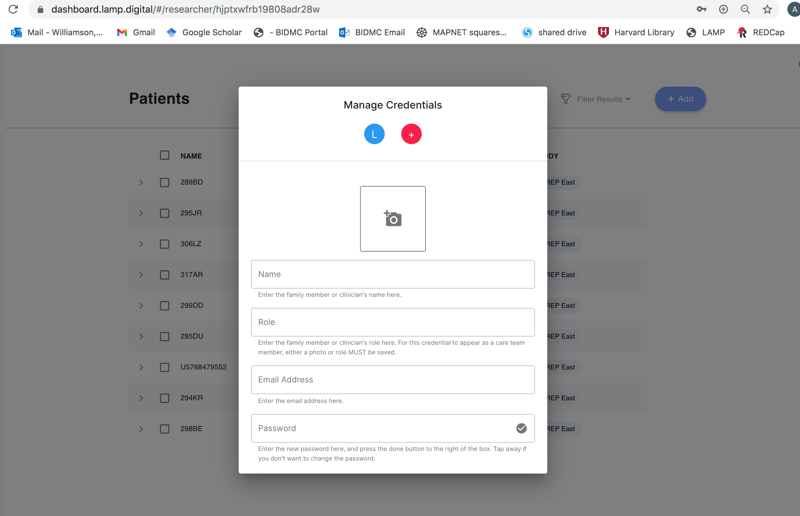
Enter the team member’s name and email. You will need to create a temporary password that can be changed once the team member accesses their account

Slide 8
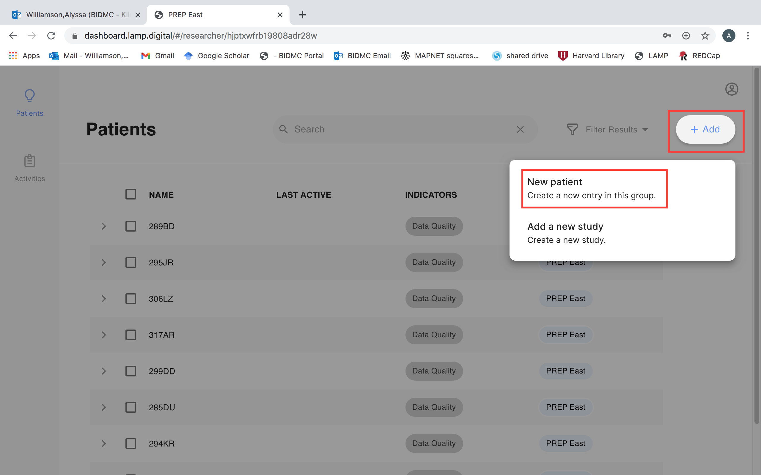
To create a new patient, select “Add,” then “Patient”

Slide 9
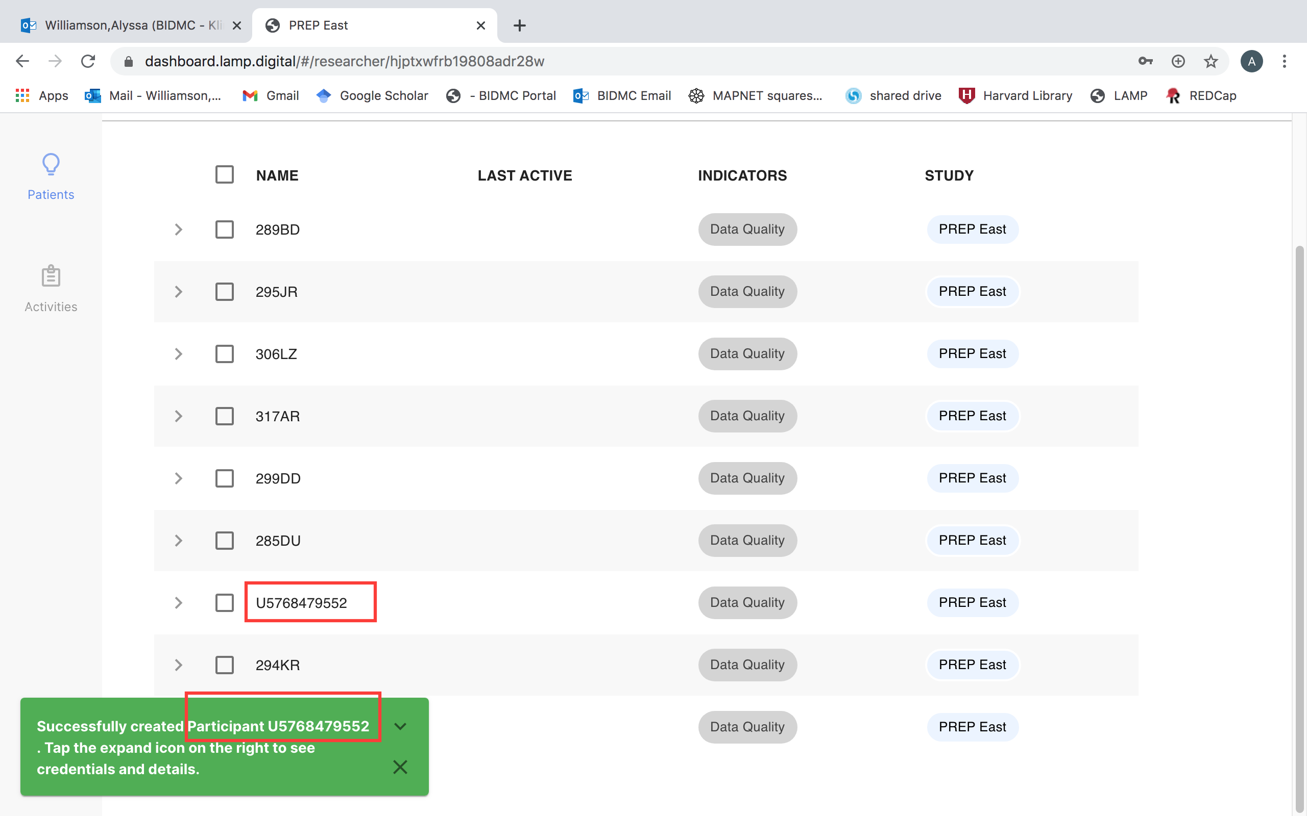
To change the name of a patient, first find the name that matches the randomly assigned ID

Slide 10
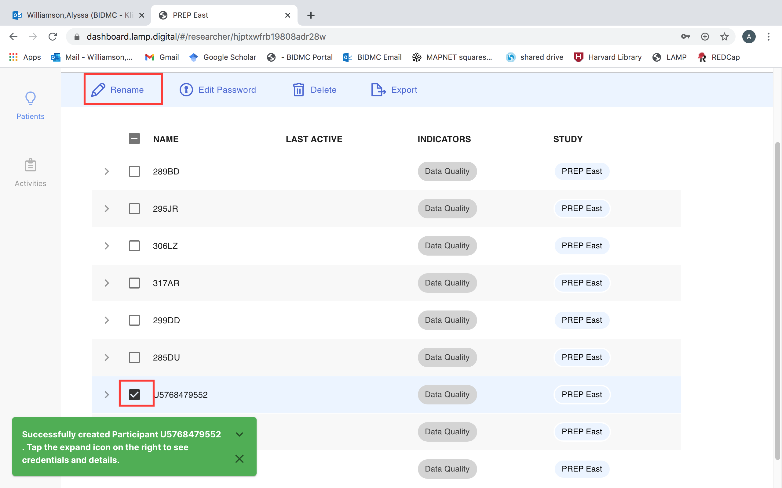
Then, click the box next to the Patient ID and select “Rename”

Slide 11
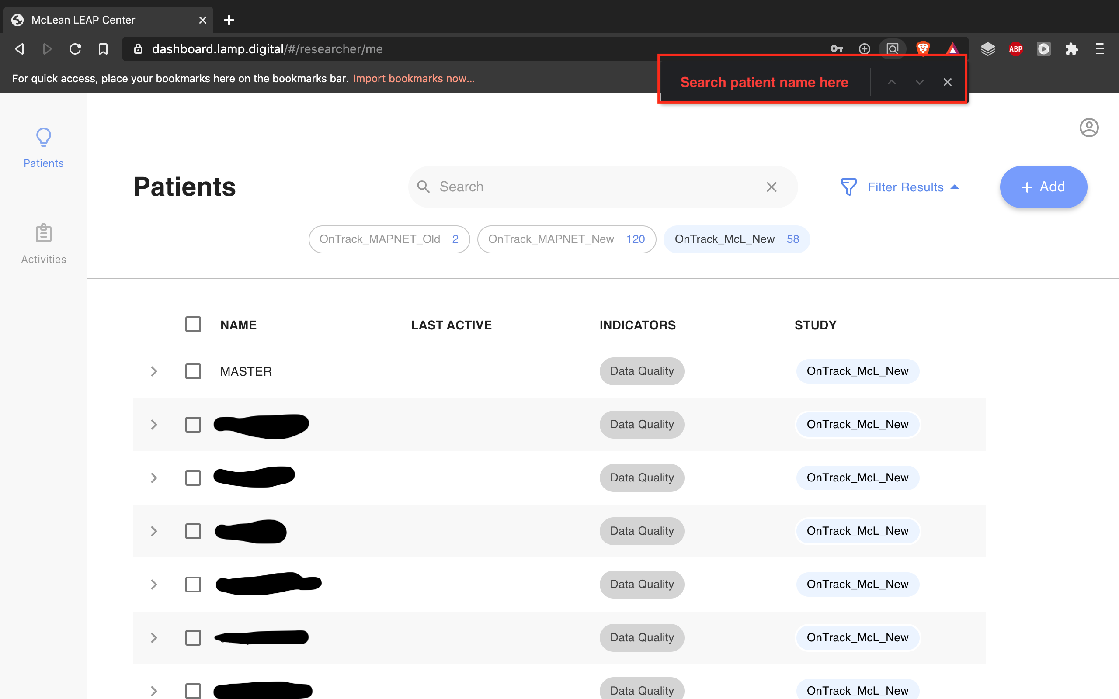
To find a patient already in LAMP, use the hotkey CTRL + F on a PC or command + F on a mac, then type in the box highlighted to search the patient’s name within the page

Slide 12
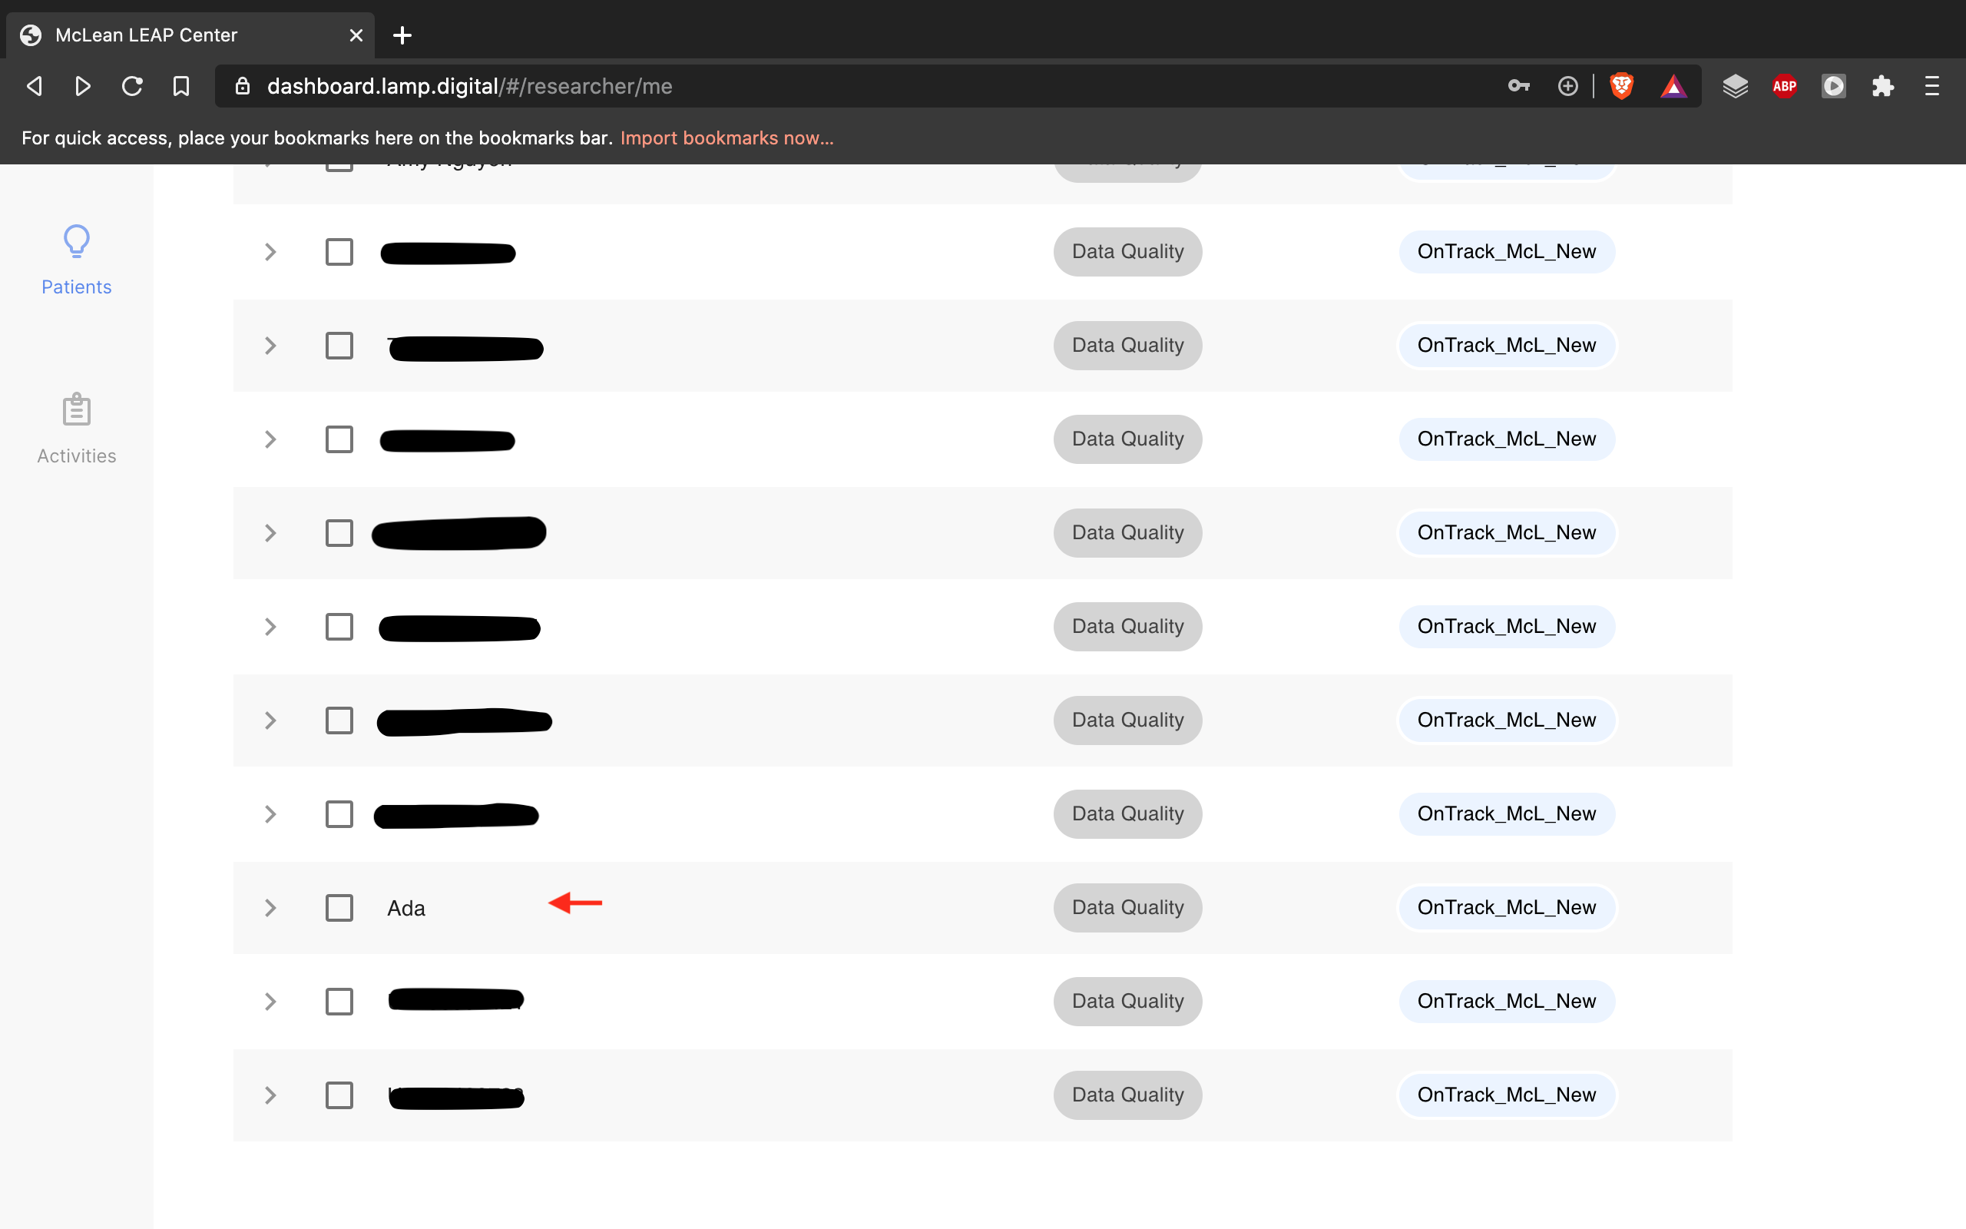
Click name of patient to proceed to assessments

Slide 13
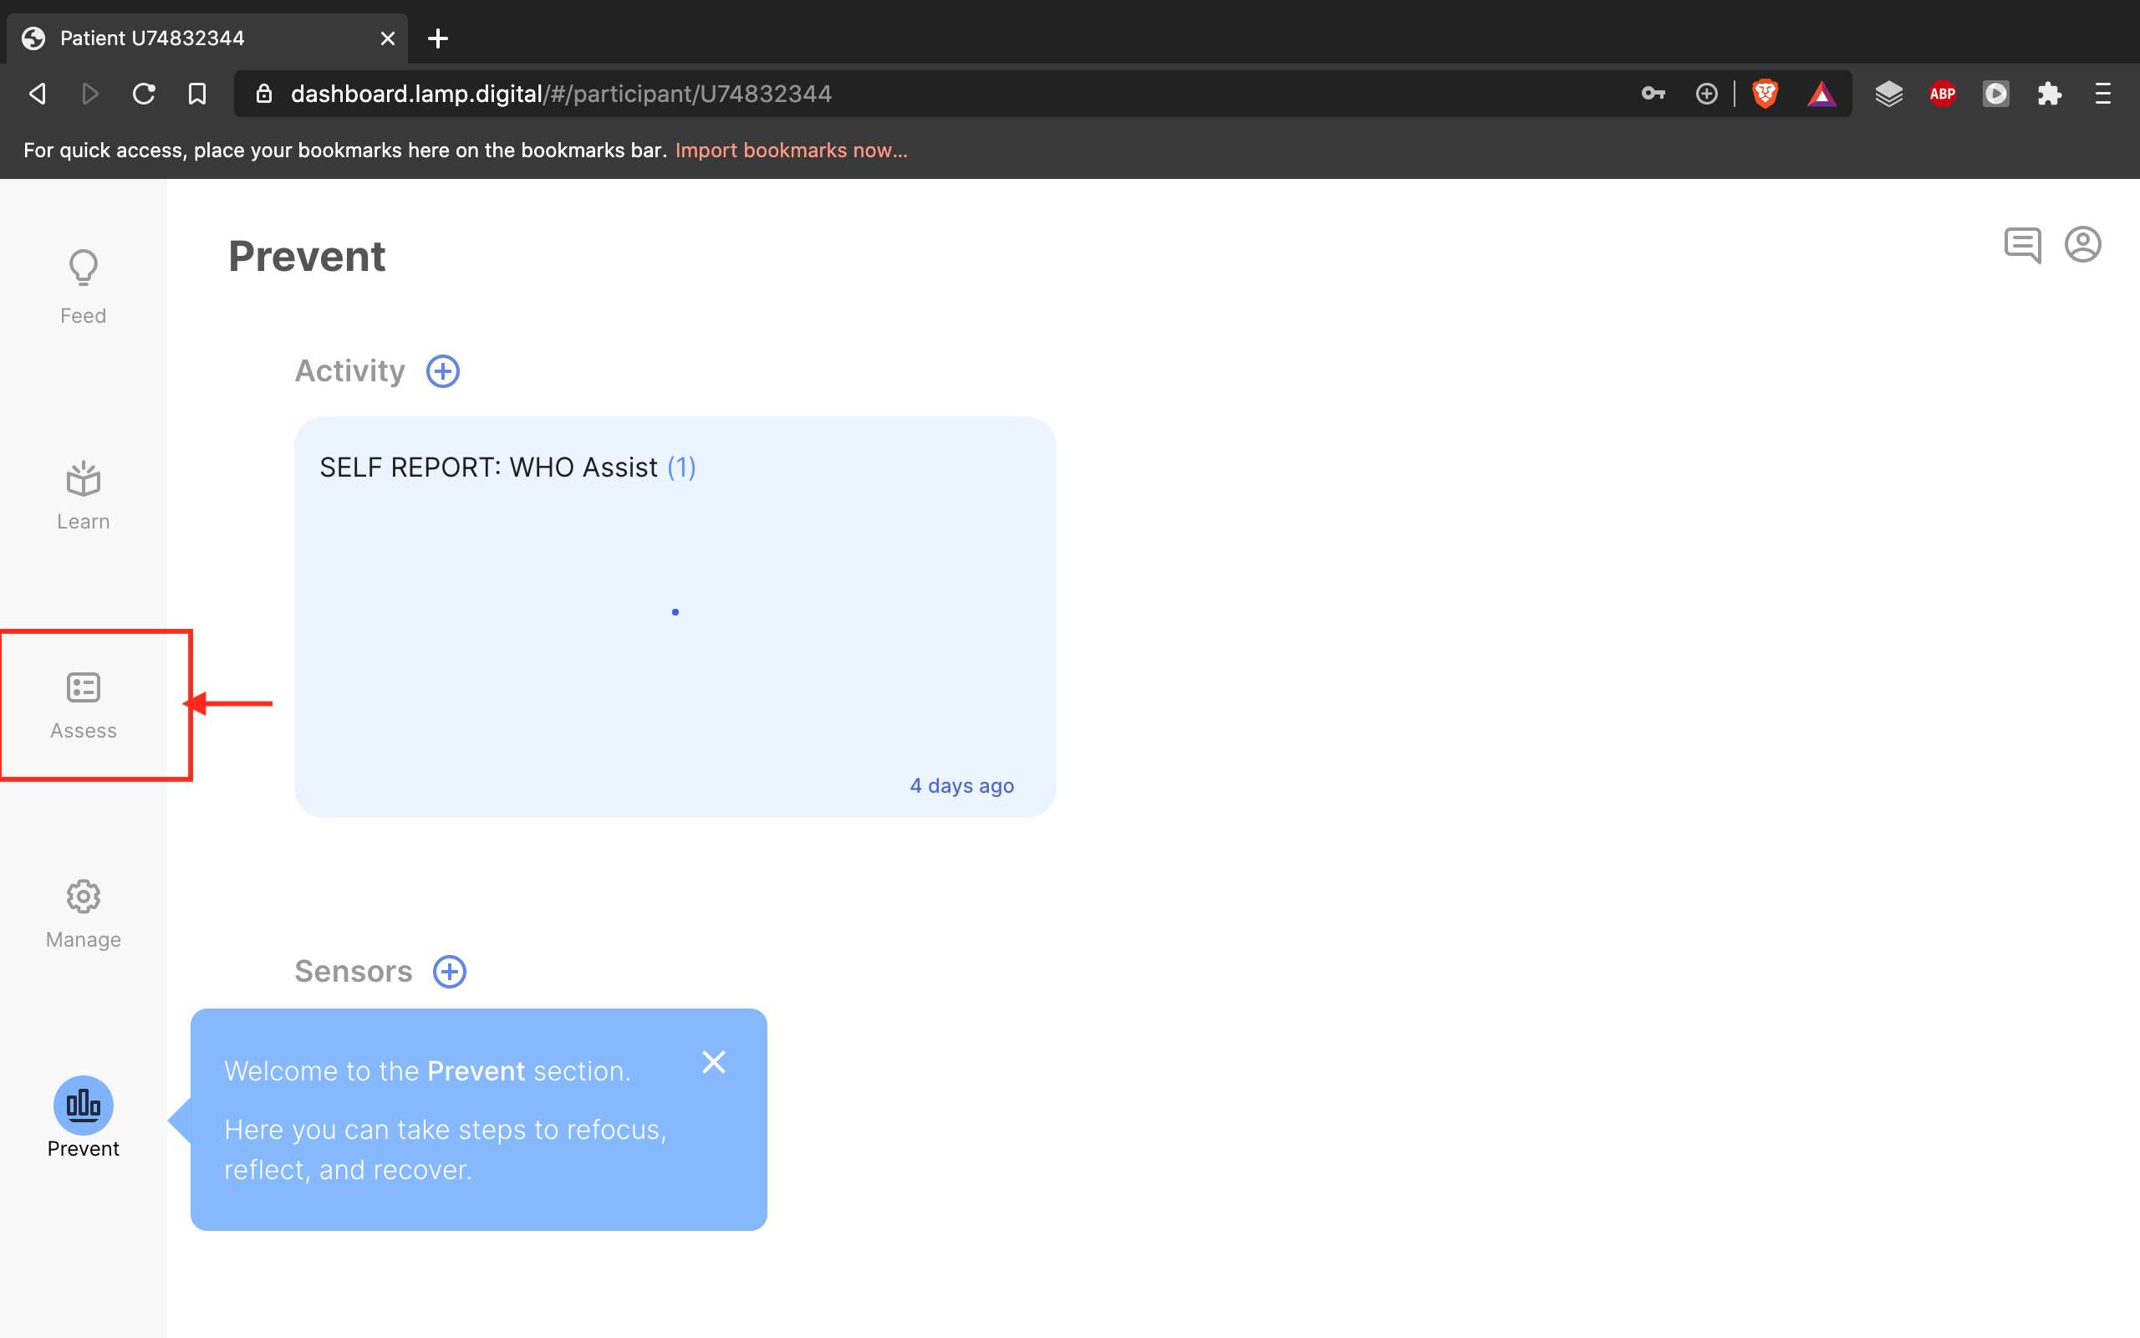
You will be sent to the ”Prevent” tab, which shows previous data. Select the “Assess” tab, highlighted here

Slide 14
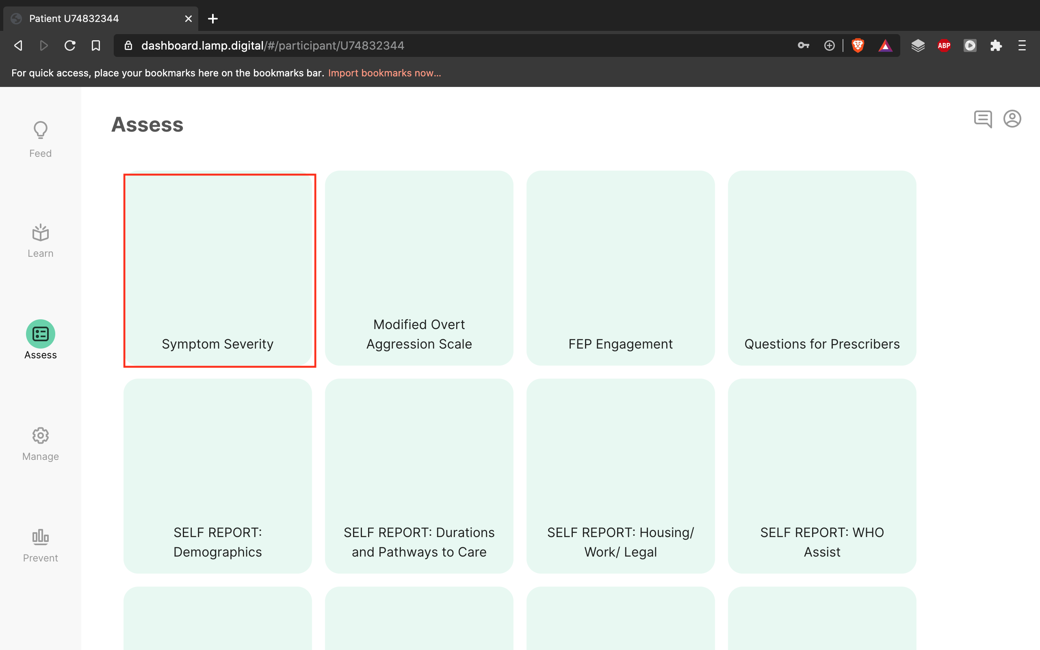
Here you will find all assessments. You can choose to share your screen with the client and read aloud or allow them to read quietly to themselves

Slide 15
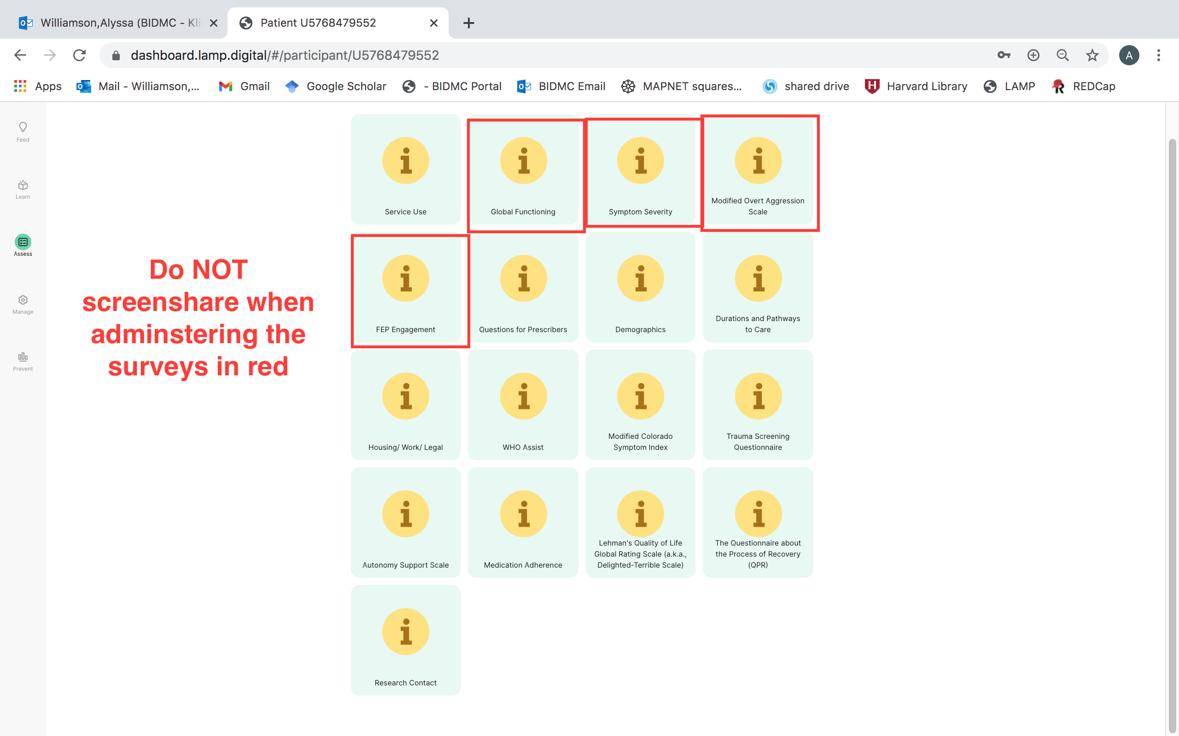
There are some assessments that you will complete without client feedback. These assessments should be kept private and NOT shown in screenshare with the client. These include: “Global Functioning,” “Symptom Severity” “Modified Overt Aggression Scale,” and “FEP Engagement”

Slide 16
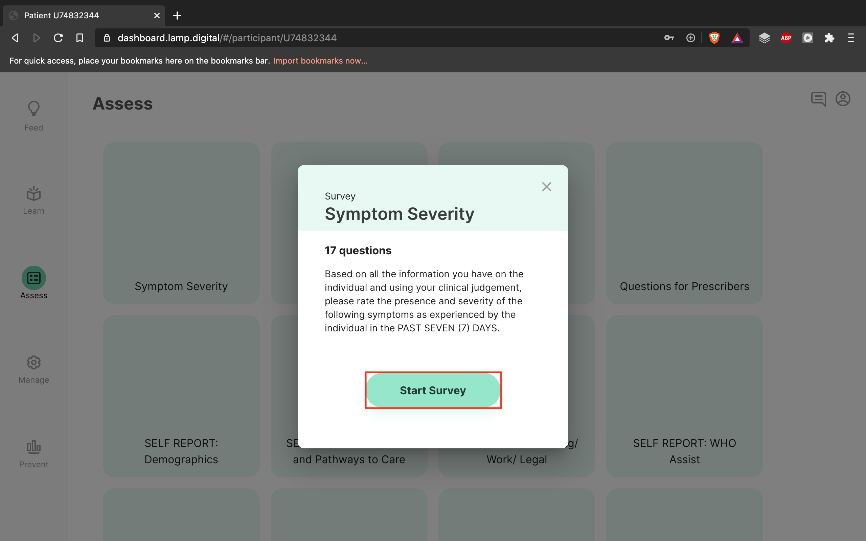
You may administer surveys in any order you wish over the course of one or multiple sessions. To begin, select “Start Survey”

Slide 17
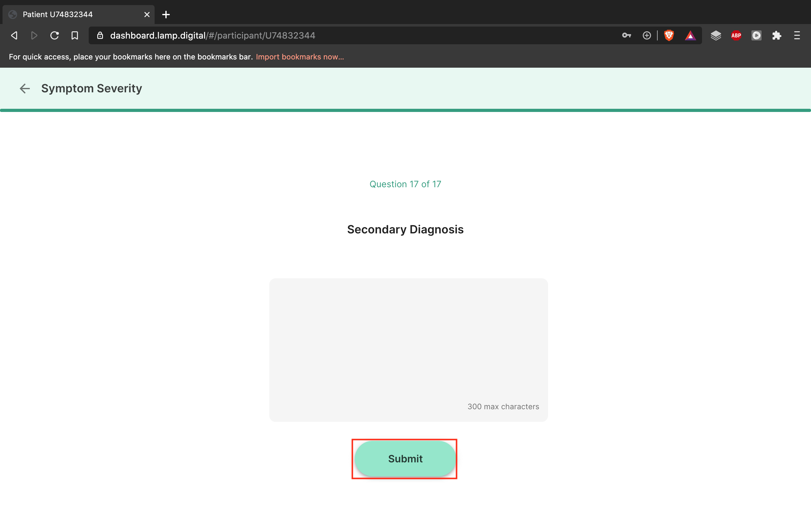
Complete the survey and then select “Submit.” At least one answer per survey is required to submit

Slide 18
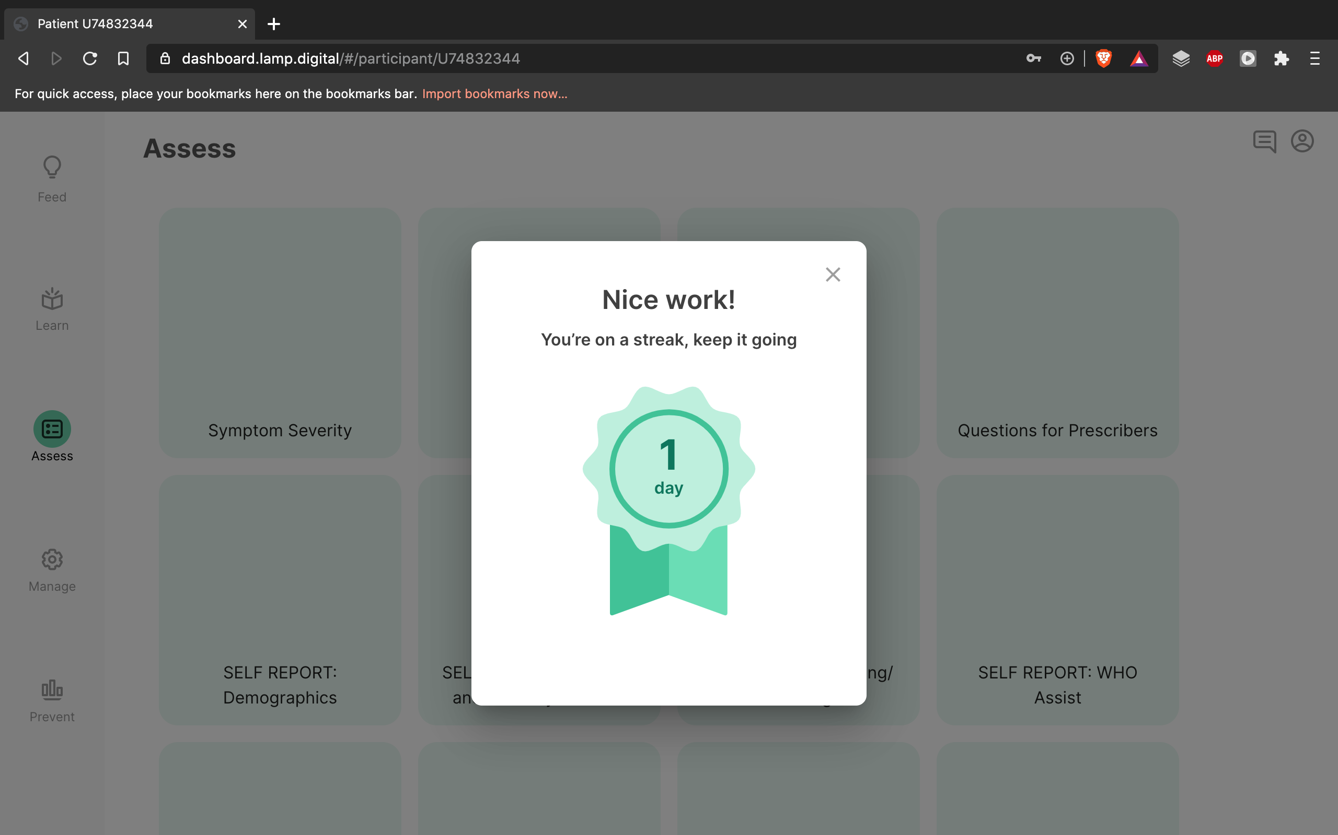
”X” out of this to continue with the other assessments

Slide 19
Stop here if you DO NOT want to review previous data

Slide 20
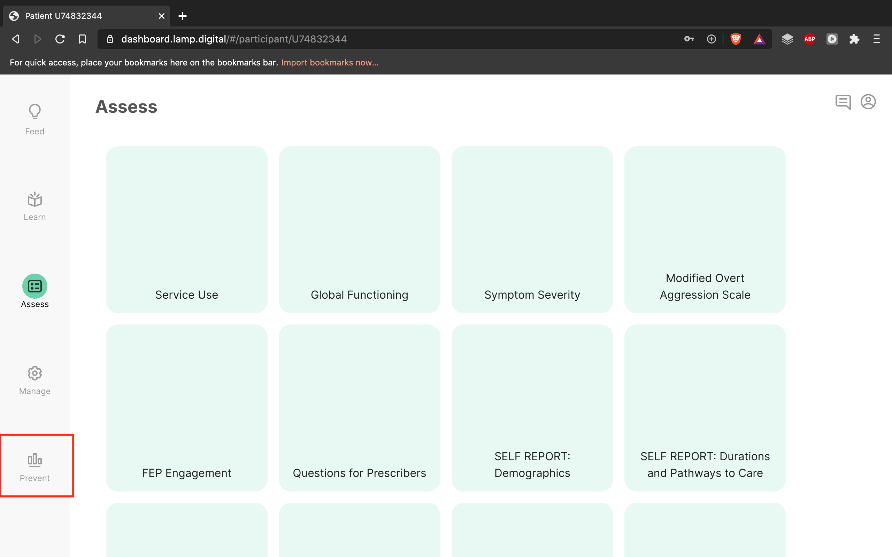
To review previous assessments, select the ”Prevent” tab

Slide 21
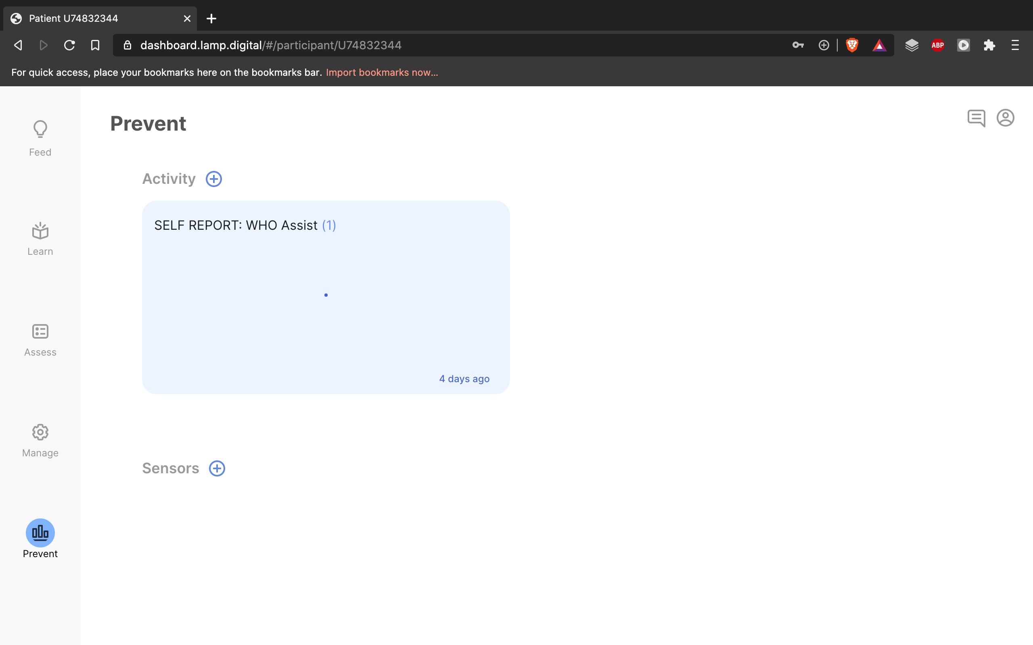
For this example, only one assessment has been completed. There may be more or fewer assessments in an actual patient’s “Prevent” tab

Slide 22
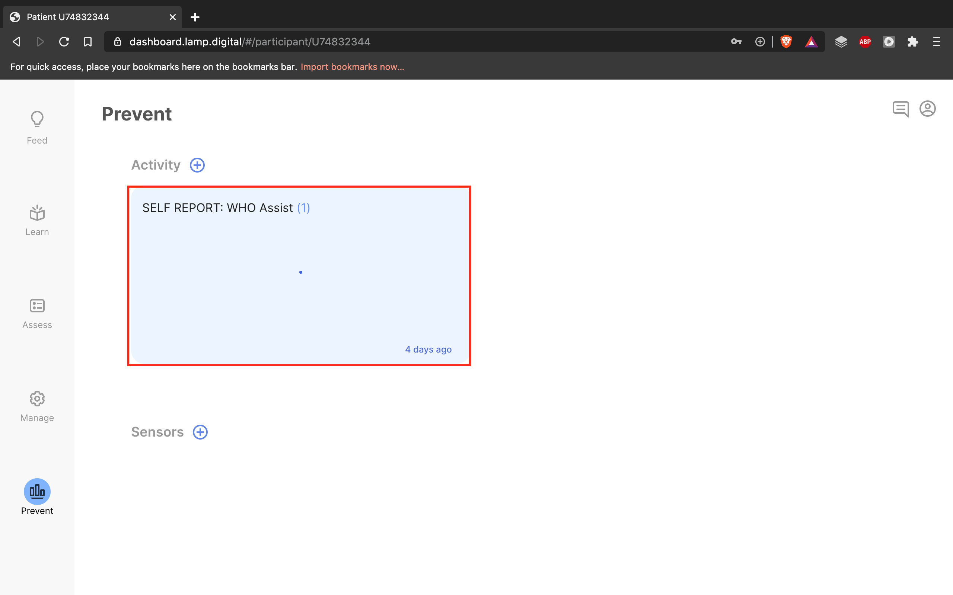
Select the assessment you would like to review

Slide 23
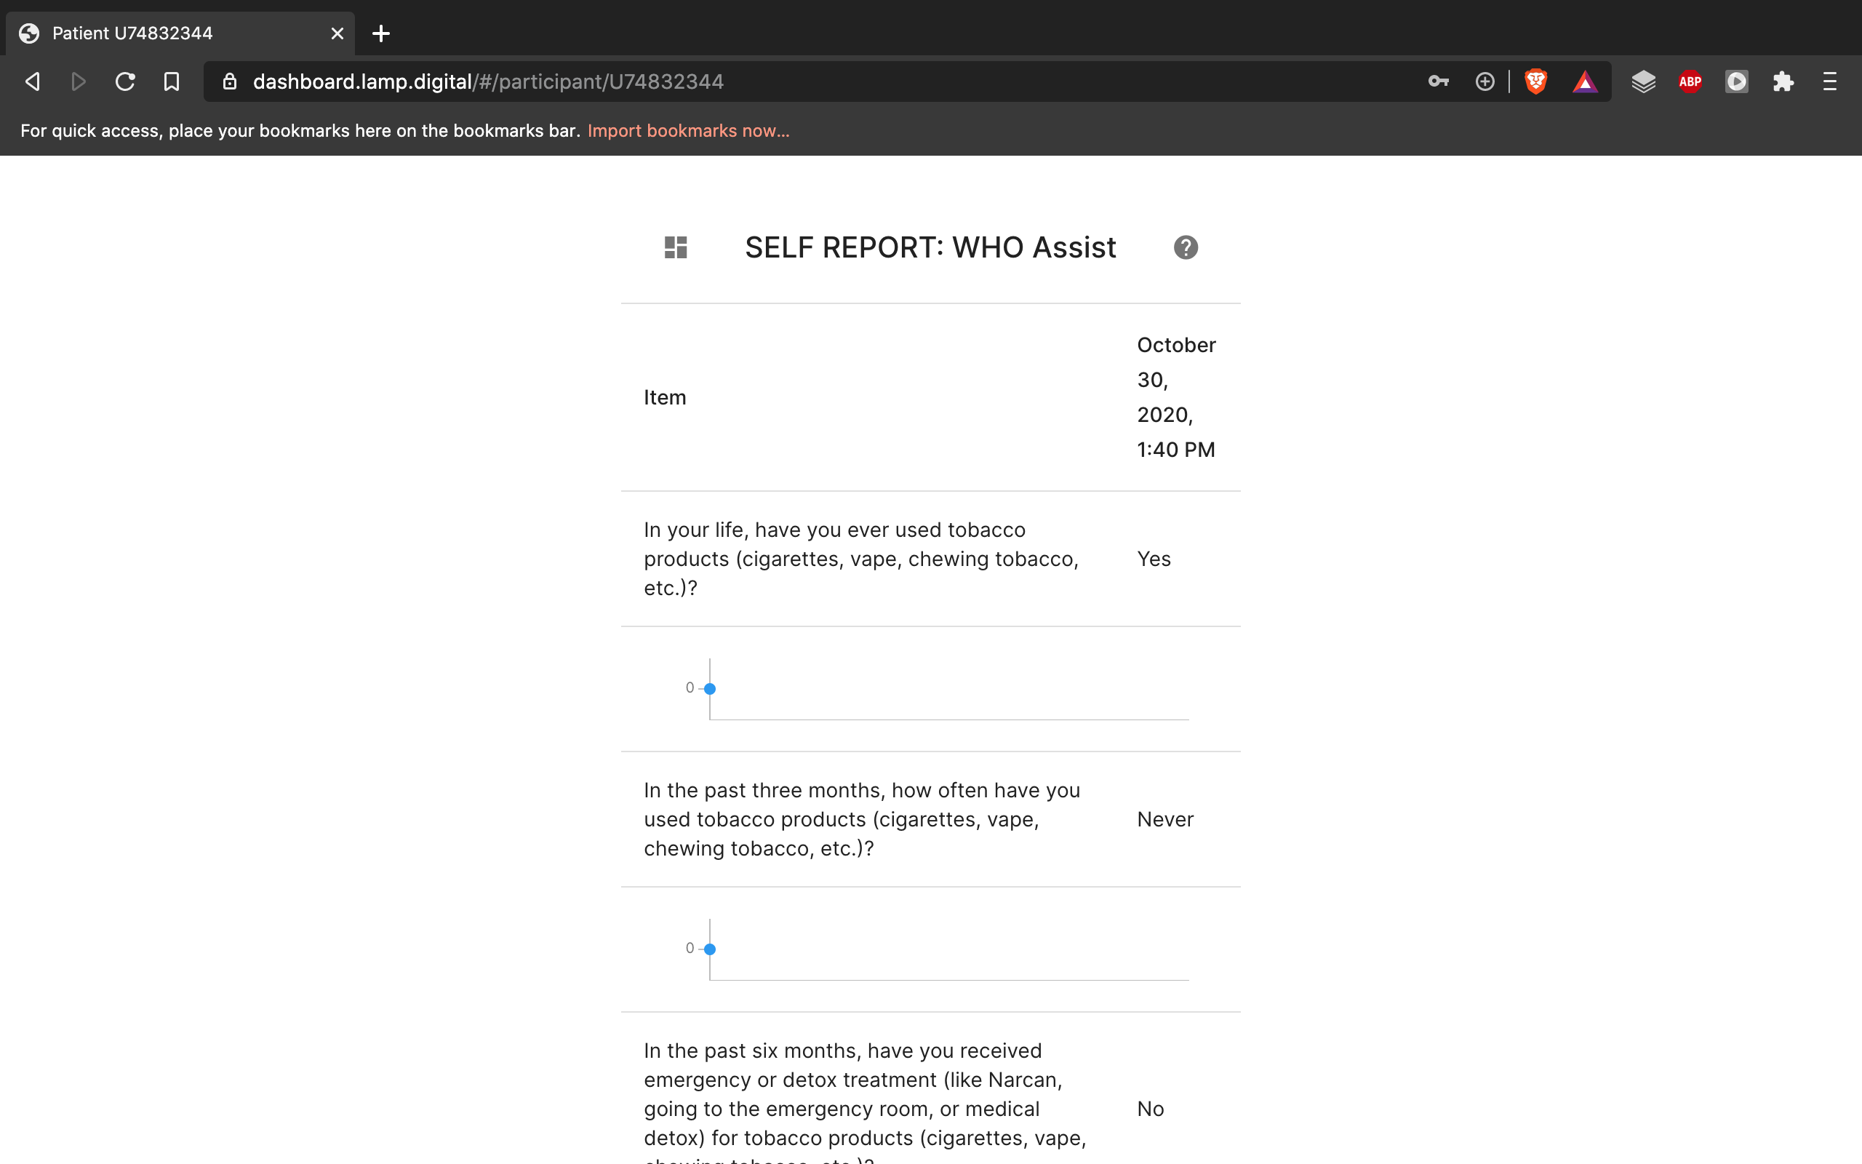
Here, you will find the completed assessment data over time

